Slide 1

AuE-8230 Autonomy: Science and Systems
Capstone Project
Group 1: Chinmay Samak, Tanmay Samak
Codebase

Slide 2
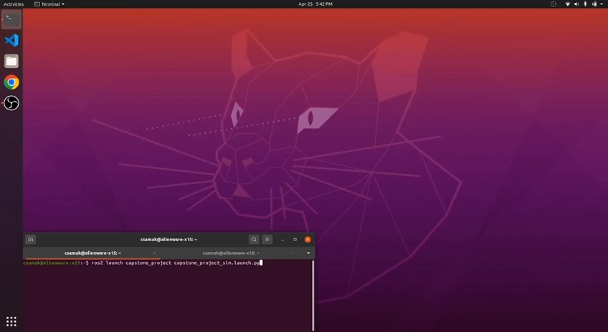
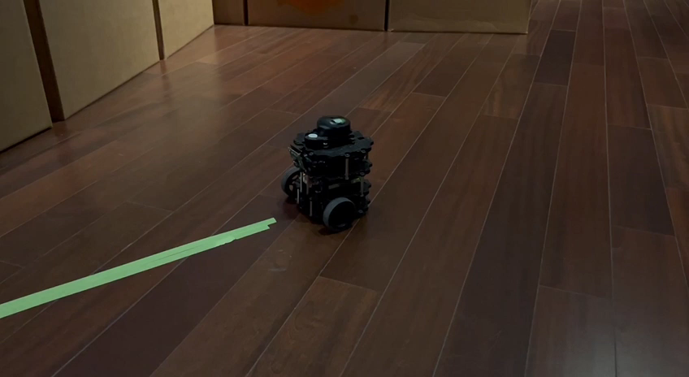
Robustness Testing
Simulation
Inverse Direction;
Start with Line Following
Reality
Night; Inverse Direction;
Start with Line Following

Slide 3
Thank you!
…open to questions and suggestions

